Slide 1
G5T4
PM Review
Members: Jaslyn, See Hoe, Yi Bing, Leonard, Serene

Slide 2
Functionalities Not planning to drop any, No PHP Frameworks
Finished:
Login for student and Admin IP Address: http://18.221.10.143/app/Login.php
Bootstrap for Administrators
In Progress:
Bid for ->section
Round 1 Admin Clearing
Cloud Deployment:
Admin Password: Help@123
IP Address: 18.221.10.143

Slide 3
Bird’s Eye View on Schedule
Iteration 1 (PM Jaslyn):
14 Sep - 27 Sep
Days: 14
Iteration 3 (PM See Hoe) :
12 Oct - 25 Oct
Days: 14
Iteration 5 (PM Serene):
15 Nov- 21 Nov
Days: 7
Iteration 2 (PM Leonard):
28 Sep - 11 Oct
Days: 14
Iteration 4 (PM Yi Bing):
26 Oct - 14 Nov
Days: 19

Slide 4
Planned Iterations
Iteration | Start | End | Weeks
1 | 14-Sep (We started early) | 27-Sep | 4,5,6
2 | 28-Sep | 11-Oct | 6, 7 (PM Review),8
3 | 12-Oct | 25-Oct | 8, 9 (Online Review),10
4 | 26-Oct | 14-Nov | 10, 11 (UAT),12
5 | 15-Nov | 21-Nov | 12, 13 (Project Submission) 17 Nov – 14 (Final Presentation)

Slide 5
Summary of Roles and Responsibilities
Iteration | Milestone | PM | Coders | Coders
1 | Ensure functionalities are up for PM Review | Jaslyn | See Hoe, Yi Bing | Leonard, Serene
2 | 1 - PM Review | Leonard | Jaslyn, See Hoe | Yi Bing, Serene
3 | 2 - Application Demo and Progress Update | See Hoe | Serene, Jaslyn | Yi Bing, Leonard
4 | 3 - UAT | Yi Bing | Jaslyn, Leonard | Serene, See Hoe
5 | 4 - Submission 5 - Final Presentation | Serene | Jaslyn, Yi Bing | Leonard, See Hoe

Slide 6
Milestones and Tasks for Each Iteration
Iteration 3:
Milestone 2: App Demo
Functionality:
Drop ->section
Drop ->bid
View bidding results
JSON
Iteration 1:
Functionality:
Login + Bootstrap
Iteration 5:
Milestone 4: Submission
Milestone 5: presentation
Iteration 2:
Milestone 1: PM Review
Functionality:
Bid ->section
Admin Starting/Clearing Round 1
Admin Starting/Clearing Round 2
JSON
Iteration 4:
Milestone 3: UAT
Functionality:
Testing and Debugging all codes

Slide 7
Buffer Time per iteration
Iteration | Buffer Time
1 | 2 days
2 | We set 10 days in total for round 1 and 2 bidding. This period includes buffer time incase we cannot complete by deadline or we have to cater to any changes.
3 | 1 day (We planned ->tight schedule for this iteration as we assume that we will not need more buffer time to create new functionalities once we get familiar with our codes)
4 | 3 days buffer before UAT to fix any bugs We do not need 7 days of testing and debugging of codes for Final submission. However, these 7 days acts as ->buffer in case we discover any incomplete functionality or critical bugs, before the submission
5 | 0. Preparation of Final presentation

Slide 8
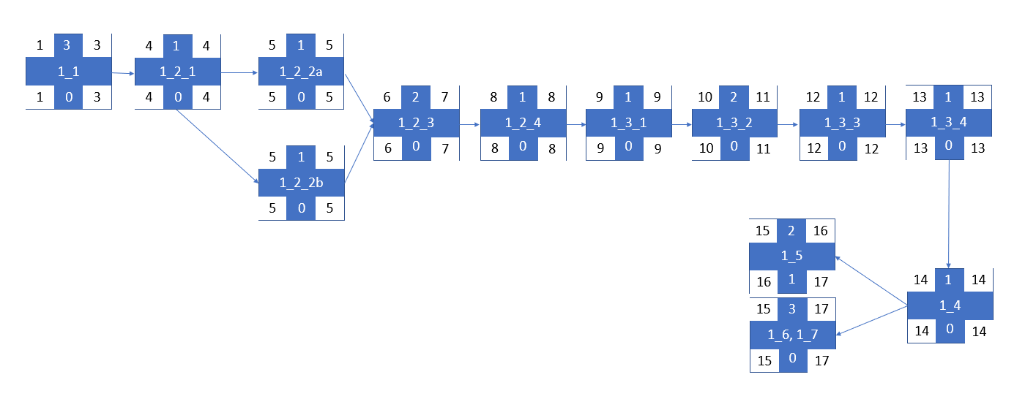
Critical Path for Iteration 1

Slide 9
Critical Path for Iteration 1
1_1 ->1_2_1 -> 1_2_2->->1_2_3 ->1_2_4 ->1_3_1 ->1_3_2 ->1_3_3 ->1_3_4 ->1_4 ->1_6, 1_7
1_1 ->1_2_1 ->1_2_2b ->1_2_3 ->1_2_4 ->1_3_1 ->1_3_2 ->1_3_3 ->1_3_4 ->1_4 ->1_6, 1_7

Slide 10
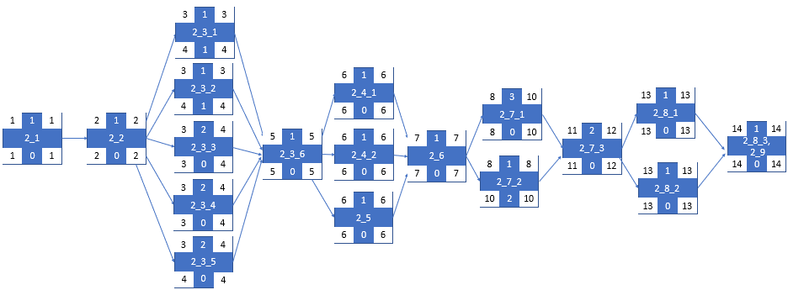
Critical Path for Iteration 2

Slide 11
Critical Path for Iteration 2
2_1 ->2_2 ->2_3_3 ->2_3_6 ->2_4_1 ->2_6 ->2_7_1 ->2_7_3 ->2_8_1 ->2_8_3, 2_9
2_1 ->2_2 ->2_3_3 ->2_3_6 ->2_4_2 ->2_6 ->2_7_1 ->2_7_3 ->2_8_1 ->2_8_3, 2_9
2_1 ->2_2 ->2_3_3 ->2_3_6 ->2_5 ->2_6 ->2_7_1 ->2_7_3 ->2_8_1 ->2_8_3, 2_9
2_1 ->2_2 ->2_3_3 ->2_3_6 ->2_4_1 ->2_6 ->2_7_1 ->2_7_3 ->2_8_2 ->2_8_3, 2_9
2_1 ->2_2 ->2_3_3 ->2_3_6 ->2_4_2 ->2_6 ->2_7_1 ->2_7_3 ->2_8_2 ->2_8_3, 2_9
2_1 ->2_2 ->2_3_3 ->2_3_6 ->2_5->2_6 ->2_7_1 ->2_7_3 ->2_8_2 ->2_8_3, 2_9
2_1 ->2_2 ->2_3_4 ->2_3_6 ->2_4_1 ->2_6 ->2_7_1 ->2_7_3 ->2_8_1 ->2_8_3, 2_9
2_1 ->2_2 ->2_3_4 ->2_3_6 ->2_4_2 ->2_6 ->2_7_1 ->2_7_3 ->2_8_1 ->2_8_3, 2_9

Slide 12
Critical Path for Iteration 2
2_1 ->2_2 ->2_3_4 ->2_3_6 ->2_5 ->2_6 ->2_7_1 ->2_7_3 ->2_8_1 ->2_8_3, 2_9
2_1 ->2_2 ->2_3_4 ->2_3_6 ->2_4_1 ->2_6 ->2_7_1 ->2_7_3 ->2_8_2 ->2_8_3, 2_9
2_1 ->2_2 ->2_3_4 ->2_3_6 ->2_4_2 ->2_6 ->2_7_1 ->2_7_3 ->2_8_2 ->2_8_3, 2_9
2_1 ->2_2 ->2_3_4 ->2_3_6 ->2_5->2_6 ->2_7_1 ->2_7_3 ->2_8_2 ->2_8_3, 2_9
2_1 ->2_2 ->2_3_5 ->2_3_6 ->2_4_1 ->2_6 ->2_7_1 ->2_7_3 ->2_8_1 ->2_8_3, 2_9
2_1 ->2_2 ->2_3_5 ->2_3_6 ->2_4_2 ->2_6 ->2_7_1 ->2_7_3 ->2_8_1 ->2_8_3, 2_9
2_1 ->2_2 ->2_3_5 ->2_3_6 ->2_5 ->2_6 ->2_7_1 ->2_7_3 ->2_8_1 ->2_8_3, 2_9
2_1 ->2_2 ->2_3_5 ->2_3_6 ->2_4_1 ->2_6 ->2_7_1 ->2_7_3 ->2_8_2 ->2_8_3, 2_9
2_1 ->2_2 ->2_3_5 ->2_3_6 ->2_4_2 ->2_6 ->2_7_1 ->2_7_3 ->2_8_2 ->2_8_3, 2_9
2_1 ->2_2 ->2_3_5 ->2_3_6 ->2_5->2_6 ->2_7_1 ->2_7_3 ->2_8_2 ->2_8_3, 2_9

Slide 13
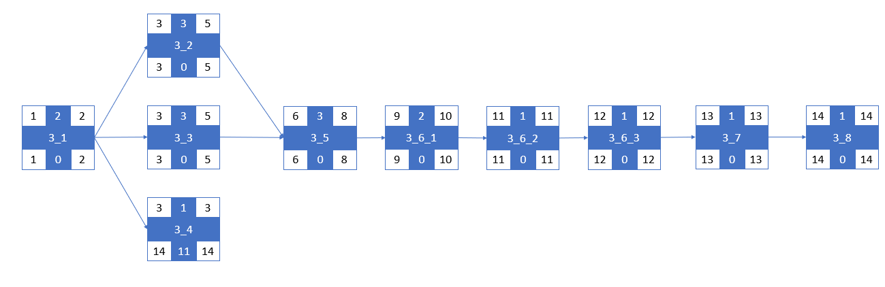
Critical Path for Iteration 3

Slide 14
Critical Path for Iteration 3
3_1 -> 3_2 ->3_5 ->3_6 _1 ->3_6_2 ->3_6_3->3_7 ->3_8
3_1 -> 3_3 ->3_5 ->3_6 _1 ->3_6_2 ->3_6_3->3_7 ->3_8

Slide 15
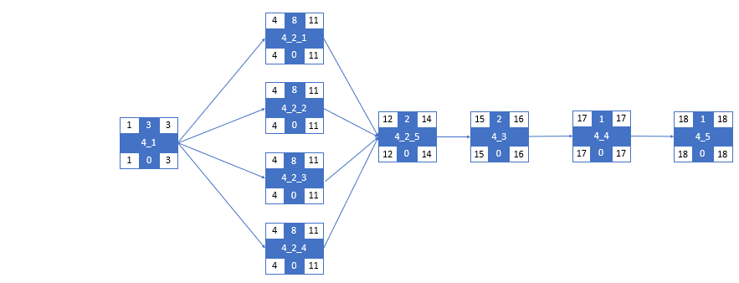
Critical Path for Iteration 4

Slide 16
Critical Path for Iteration 4
5_1 ->5_2_1 ->5_3->5_4->5_5
5_1 ->5_2_2 ->5_3->5_4->5_5
5_1 ->5_2_3 ->5_3->5_4->5_5
5_1 ->5_2_4 ->5_3->5_4->5_5

Slide 17
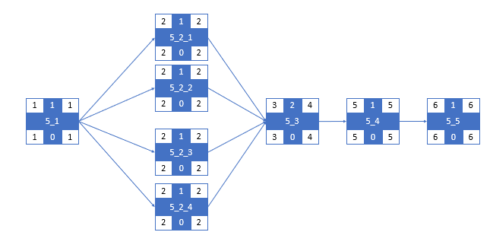
Critical Path for Iteration 5

Slide 18
Critical Path for Iteration 5
5_1 -> 5_2_1 ->5_3->5_4->5_5
5_1 -> 5_2_2 ->5_3->5_4->5_5
5_1 ->5_2_3 ->5_3->5_4->5_5
5_1 ->5_2_4 ->5_3->5_4->5_5

Slide 19
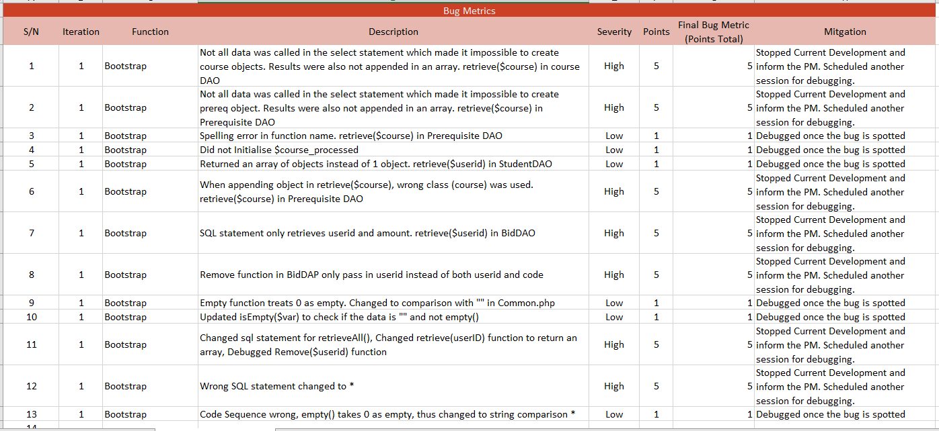

Slide 20
Bug Metrics
Total Bug Metrics: 41
Bugs with 1 point were detected and solved immediately.
Mitigation: When more bugs with 5 points were detected, ->debugging session was scheduled on 24/9/2019 to meet and had ->discussion with the coders to resolve the bugs.
All the bugs have been resolved.

Slide 21
Summary of Roles and Responsibilities
Iteration | Milestone | PM | Coders | Coders
1 | Ensure functionalities are up for PM Review | Jaslyn | See Hoe, Yi Bing | Leonard, Serene
2 | 1 - PM Review | Leonard | Jaslyn, See Hoe | Yi Bing, Serene
3 | 2 - Application Demo and Progress Update | See Hoe | Serene, Jaslyn | Yi Bing, Leonard
4 | 3 - UAT | Yi Bing | Jaslyn, Leonard | Serene, See Hoe
5 | 4 - Submission 5 - Final Presentation | Serene | Jaslyn, Yi Bing | Leonard, See Hoe

Slide 22
Iteration 1: Responsibilities
Roles | Roles Description / Tasks | Assigned Member
Project Manager | Daily Updates Schedule Planning for all Iterations Manage Schedule Prepare team for PM Review | Jaslyn
Pair 1 | Bootstrap for Section, Course, Prerequisites Login | See Hoe, Yi BIng
Pair 2 | Bootstrap for Bid, Course_completed, Student | Serene, Leonard

Slide 23
Iteration 2: Responsibilities
Roles | Roles Description / Tasks | Assigned Member
Project Manager | Daily Updates Manage Schedule Ensure commits are on time Prepare for PM Review | Leonard
Pair 1 | Round 1 & 2 Starting and Clearing Admin Page JSON Login, Bootstrap, Dump Table, Start round, Stop round | Jaslyn, See Hoe
Pair 2 | Round 1 & 2 Bid for ->section Student Bid Page | Serene, Yi Bing

Slide 24
Iteration 3: Responsibilities
Roles | Roles Description / Tasks | Assigned Member
Project Manager | Daily Updates Schedule Planning for all Iterations Manage Schedule and ensure team is ready for application demo | See Hoe
Pair 1 | Drop ->bid Drop ->section JSON Update Bid, Drop Section | Jaslyn, Serene
Pair 2 | View Bidding results JSON Dump (User, Bid, Section) | Yi Bing, Leonard

Slide 25
Iteration 4: Responsibilities
Roles | Roles Description / Tasks | Assigned Member
Project Manager | Daily Updates Schedule Planning for all Iterations Manage Schedule and ensure team is ready for UAT | Yi Bing
Pair 1 | Testing: Round 1 and 2 Bidding and clearing | Jaslyn, Leonard
Pair 2 | Testing: Login and Bootstrap | See Hoe, Serene

Slide 26
Iteration 5: Responsibilities
Roles | Roles Description / Tasks | Assigned Member
Project Manager | Daily Updates Schedule Planning for all Iterations Manage Schedule and ensure team is ready for Submission and Final Presentation | Serene
Pair 1 | Prepare slides and demo for Final Presentation | Jaslyn, Yibing
Pair 2 | Prepare slides and demo for Final Presentation | Leonard, See Hoe

Slide 27
Pair programming teams and rotation plan
Pair 1 | Iteration | Pair 2
See Hoe, Yi Bing | 1 | Leonard, Serene
Jaslyn, See Hoe | 2 | Yi Bing, Serene
Serene, Jaslyn | 3 | Yi Bing, Leonard
Jaslyn, Leonard | 4 | Serene, See Hoe
Jaslyn, Yi Bing | 5 | Leonard, See Hoe

